Slide 1
Bachelor of Social & Environmental Sustainability
Rongo o te Wā
Notes:
Introduce yourself :)

Slide 2
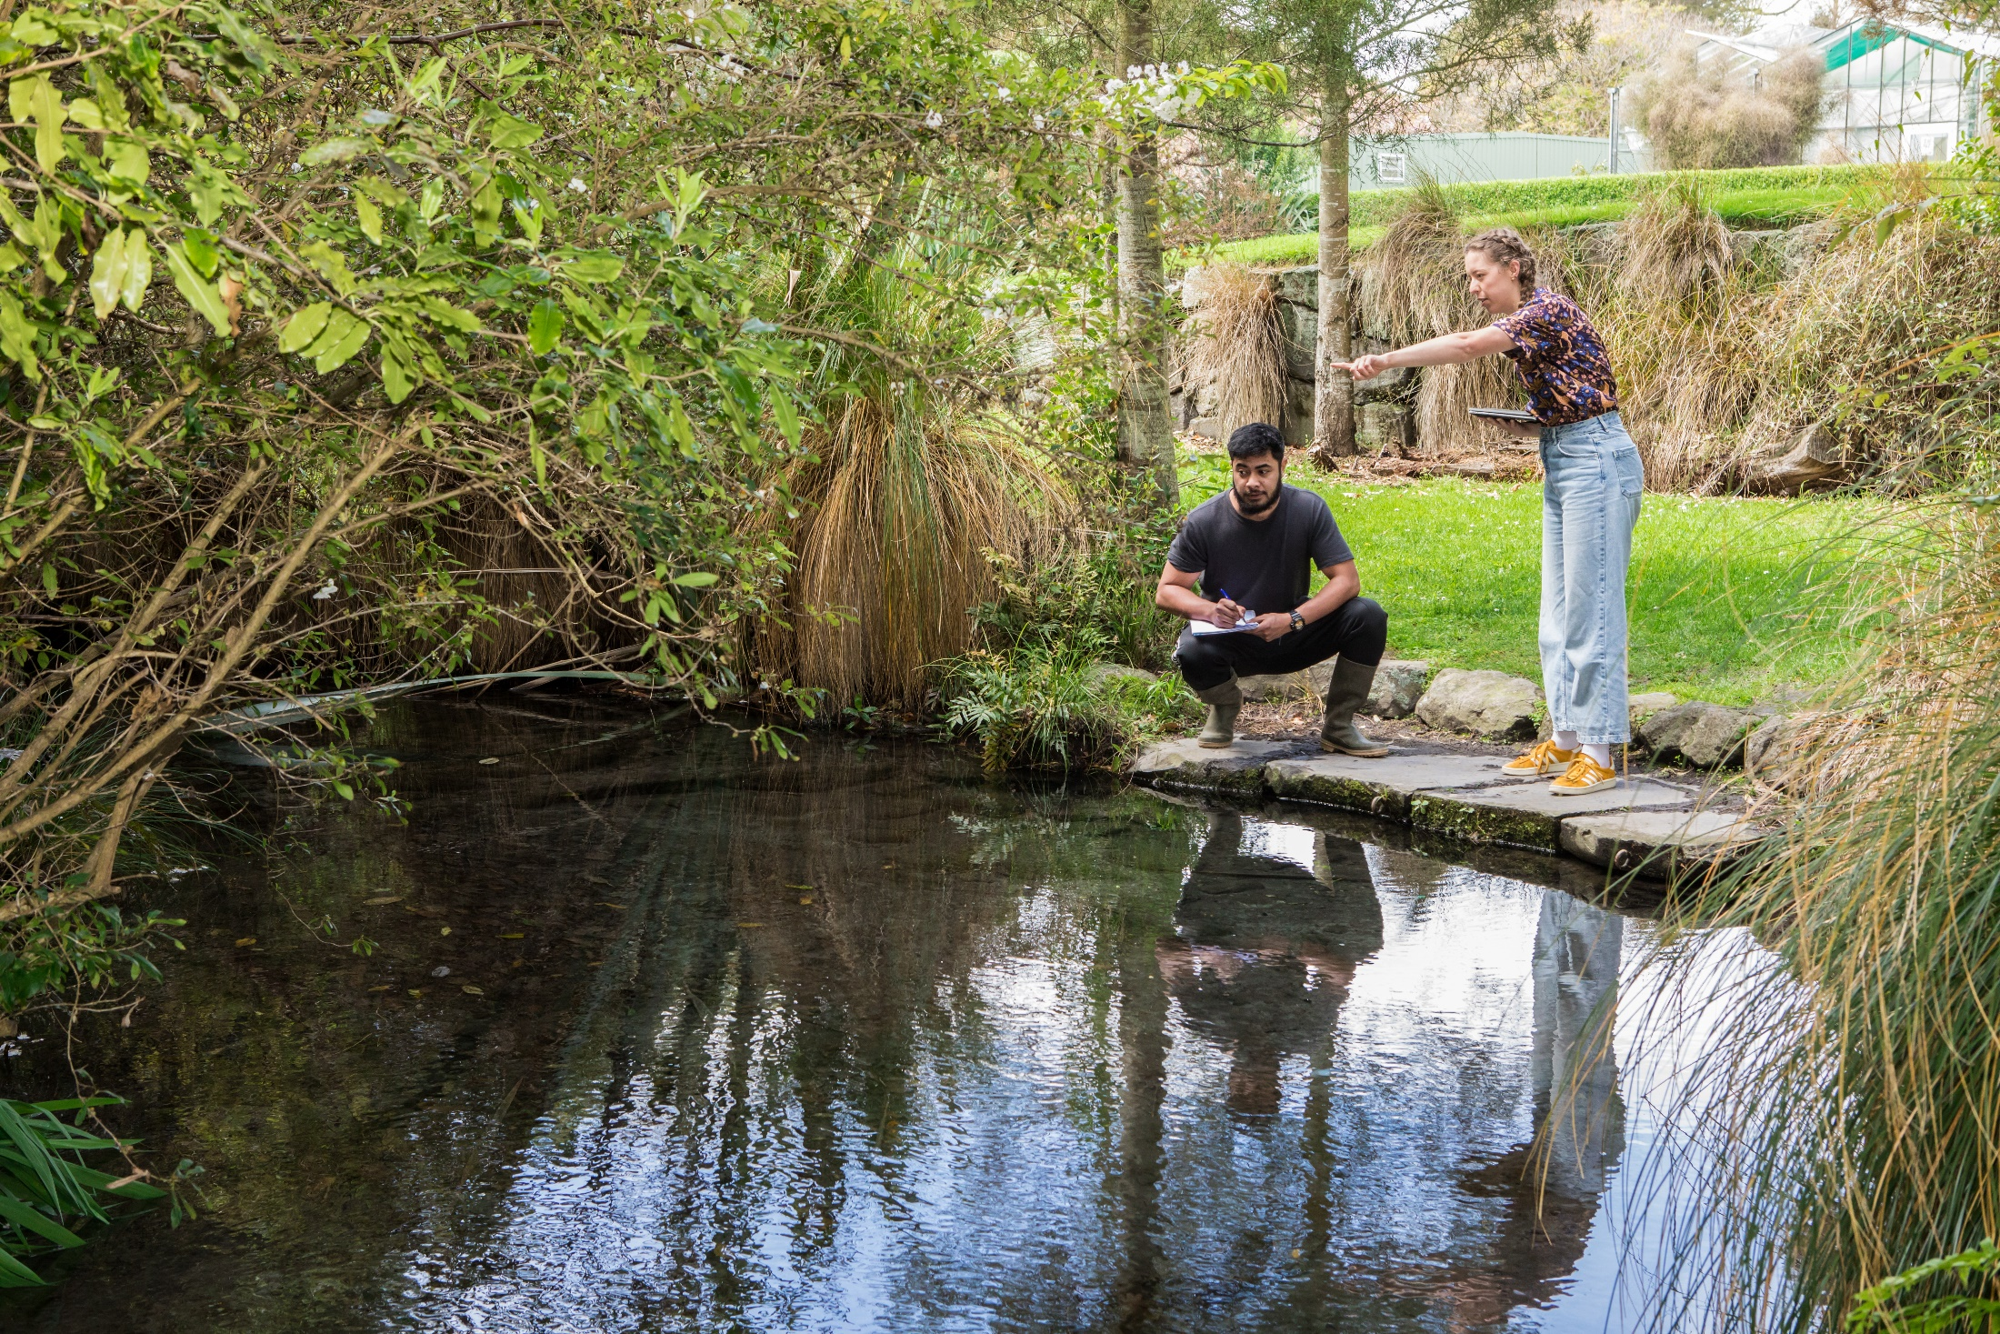
What is sustainability?
‘the ability to develop in ways that meet
our own needs without compromising
the ability of future generations to meet
their needs.’
Notes:
The only undergrad degree in Aotearoa that focuses on all areas of sustainability — from social to economic to environmental.
Multidisciplinary 3 year degree; drawing from socio-ecological insights from politics, philosophy, ethics, Māori and indigenous studies, environmental law, governance and leadership, sociology, history, economics, business, marketing, psychology, management and communications
It explores the biggest global problems we have caused by injustice towards the environment and to communities, from pollution and climate change to world hunger. Courses come from a variety of different subjects — including Environmental Science, Policy, and Marketing — so you can get a full view of the global issues that you are passionate about and learn how you can achieve behaviour change and social action.
Uses UC’s local and global contacts with entrepreneurs, environmental scientists, tangata whenua, and other change makers.

Slide 3
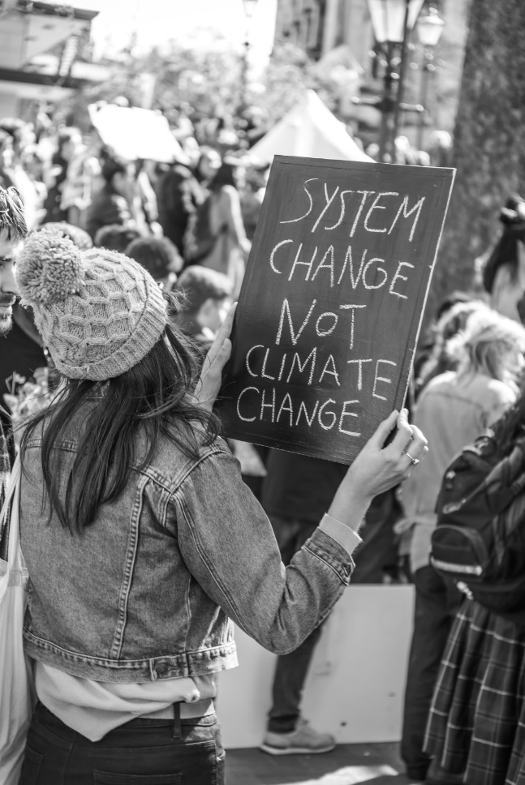
What Does Studying Sustainability involve?
The study of how we
can make a difference in
our society, environment and
economy to the future;
as citizens, businesses, Iwi,
and community advocates working
locally nationally and internationally.

Slide 4
Bachelor of Social Work BSW (Hons)
Notes:
Josiah – studying towards a BA Honours in History

Slide 5
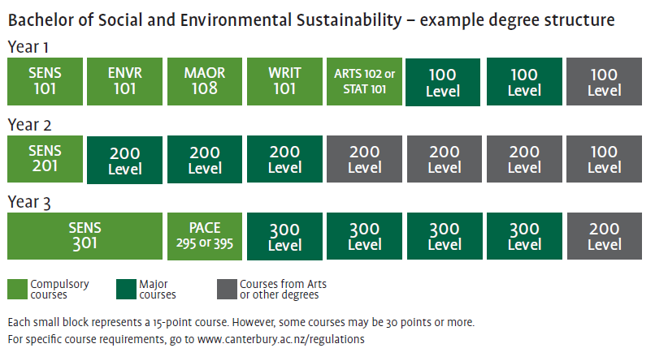
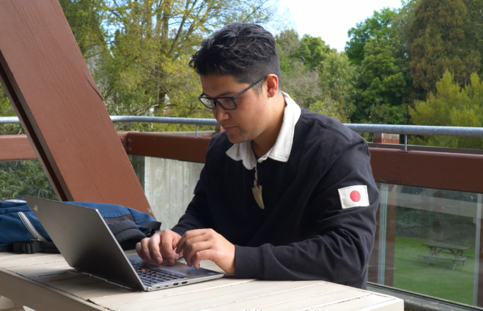
Bachelor of Social & Environmental Sustainability BSEnS
Josiah
BA in Political Science and History
BA(Hons) in History
Majors
Environmental Policy, Governance & Social Justice
Indigenous Knowledge & Sustainable Partnerships
Social Action, Community & Global Development
Sustainable Business, Enterprise & Economics
Pace: 2/3 yr Internship
Notes:
Four majors (chosen from first year):
Environmental Policy, Governance and Social Justice
Indigenous Knowledge and Sustainable Partnerships
Social Action, Community and Global Development
Sustainable Business, Enterprise and Economics
Can include optional minor from other degrees at UC (BA, BC, BCom, BSci, BYCL).
All students take 5 compulsory courses in their first year and two papers towards their major.
Courses in the first year include:
SENS101 Introduction to the Principles and Concepts of sustainability
ENVR101 Introduction to Environmental Science
MAOR108 Aotearoa: Introduction to NZ Treaty Society
WRIT101 Writing for Academic success
ARTS102 Problems, Questions, Evidence or STAT101 Statistics 1
The degree includes a final year internship with a local business so you can get real experience making a difference.

Slide 6
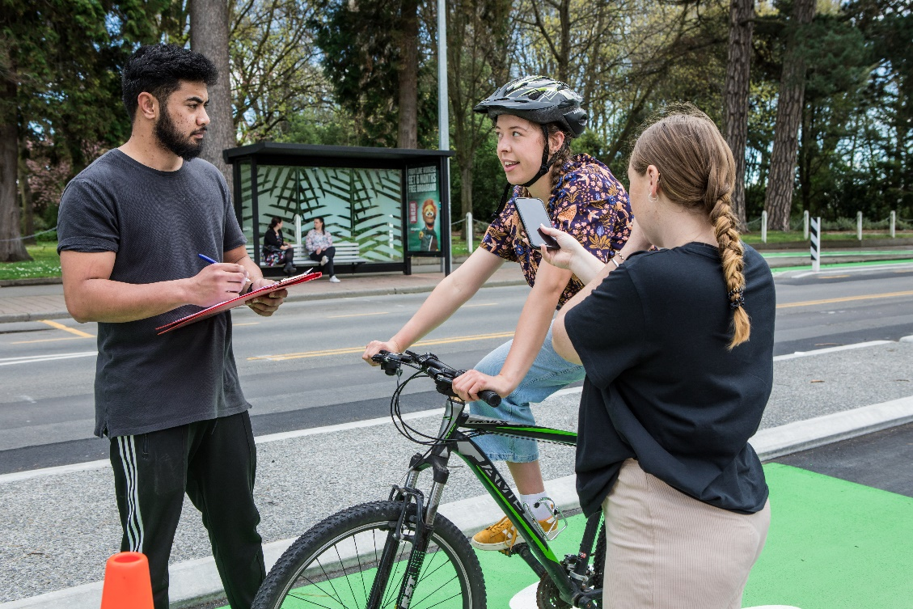
Environmental Policy, Governance and Social Justice
Students learn about sustainability from a policy and social justice point of view
Courses in political science and law, philosophy and ethics, economics, social enterprise, sociology, and psychology
Career opportunities in government (local to international) for policy and advice & decision making
Business planning, marketing and communication for sustainability/low carbon futures
Notes:
Learn about sustainability from a policy and social justice point of view.
How do we achieve a fairer, more sustainable future? It requires knowledge from politics, law, social behaviour, and economics.
Competition, colonialism conflict, overconsumption and production, can drive problems including pollution, climate change, and human rights and employment and indigenous land disputes.
Examine how global, national and local sustainability and social equity issues can be addressed with actionable policy change.
Career Opportunities: National and international government, business and policy advisory, marketing and communications, and business operations

Slide 7
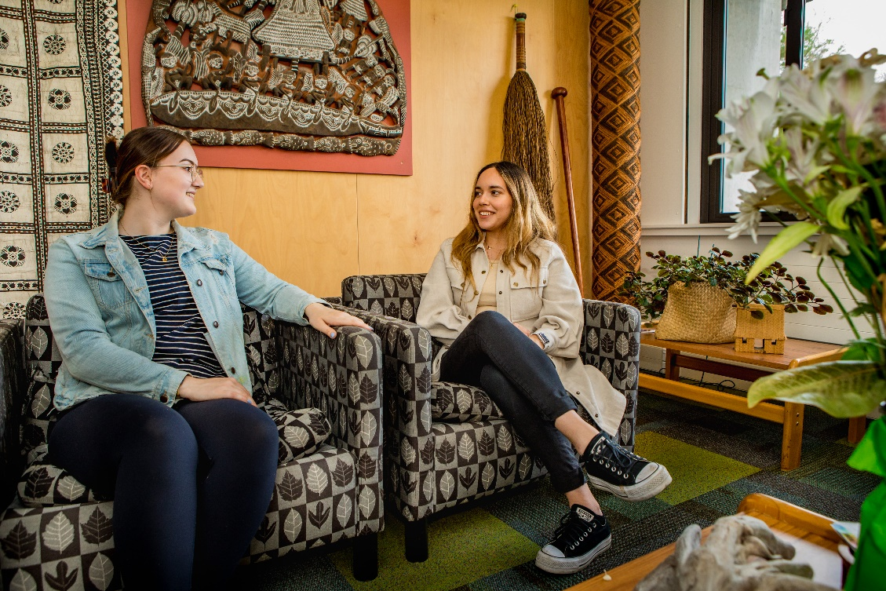
Indigenous Knowledge and Sustainable Partnerships
Learn how to form relationships and support communities, regions, and businesses transform their cultural values and sustainable practices
Follow interests in areas such as activism, policy, natural resource management, business, economics, and health
Career opportunities working with community, government, business and policy advisors, and advocates
Notes:
In this major we discuss how making a difference in our global sustainability requires lived experiences, and builds diverse world views and histories of all cultures.
This major recognises that efforts to engage respectfully with Indigenous and local knowledges are critical to effective problem solving. Develop collaboration and leadership values, including for example, respect and understanding of manaakitanga (hospitality) and whakawhanaungatanga (connections).
Learn how to work as partners effectively with Mana whenua and other Indigenous communities to advance the aspirations of local communities and the goals of sustainability and wellbeing for all.
Many industries seek out graduates with leadership skills and cultural awareness. Career Opportunities working with community, government, business and policy advisors, and advocates

Slide 8
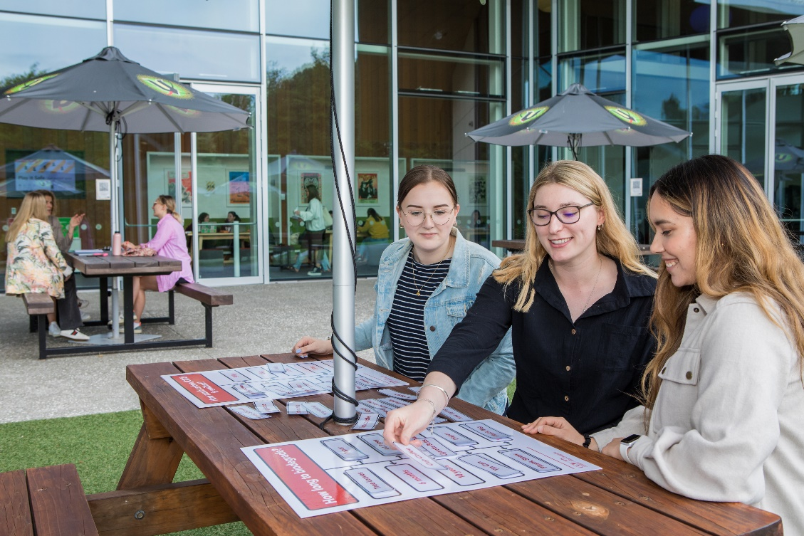
Social Action, Community and Global Development
Learn the skills needed to help solve issues we face globally: from hunger crisis to global poverty; city development to climate change
Study a wide range of courses from sociology and psychology, politics, international relations, media, geography, environmental studies, and community development
Career opportunities in business, local national and international governments, aid agencies, NGOs champions for change
Notes:
Help solve some of the major issues we face globally by learning how to create campaigns that deal with problems caused by the ways we interact with the environment and each other, from the hunger crisis to global poverty, renewable energy to pollution, city development to climate change, and more.
Learn to think critically about the role of international aid, investment, development, NGOs, and how civil society is mobilised locally to globally to lead change.
Career Opportunities: Business, national and international governments, Aid agencies, investment advisor, NGOS

Slide 9
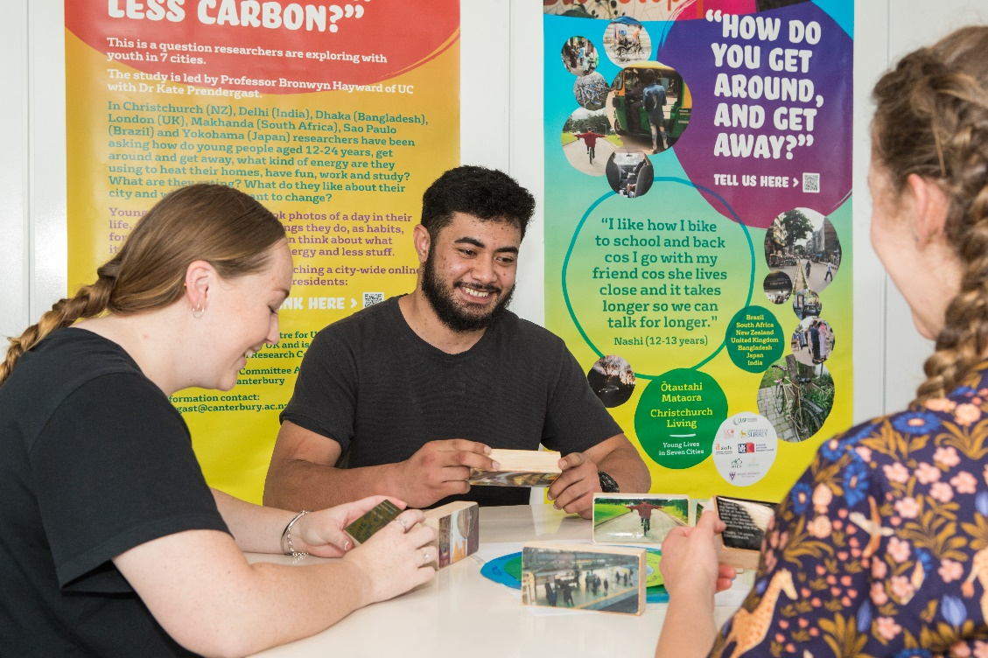
Sustainable Business, Enterprise and Economics
All businesses need more people with the skills to help manage economic success while also contributing positively to environmental and social outcomes
Courses cover the business basics of management, economics, accounting, marketing, or communications
Career opportunities will vary based on functional focus (e.g marketing, accounting, operations). The degree will open students up to management roles, consultant roles, and analyst roles
Notes:
All businesses (for profit, non-profit, start-ups, local or international) have one thing in common: they need more people with the skills to help manage economic success while also contributing positively to environmental and social outcomes
e.g., managing pollution and use of natural resources
e.g., supporting communities in which they operate
Develop business skills (accounting, finance, economics, marketing, management, supply chain management) while developing your knowledge and skills regarding sustainability. Learn how these affect our views and treatment of the environment and communities
Opportunities to create your own business with UC's mentors, business connections, and a Makerspace.
Career opportunities: Every industry needs to find more sustainable practices, and there are few people in the current job market with knowledge of both business and environmental science and issues to help achieve this. Your problem-solving skills will help lead us to better corporate responsibility and sustainable consumption of goods.
Career pathways would initially be based on your functional focus (e.g., accounting, marketing, operations, entrepreneurship)
Management roles – be a decision-maker to guide business decision-making
Consultant roles – work in a consulting firm to help educate and inform businesses seeking sustainability guidance
Analyst roles – provide analysis and projections of business trends, environmental/social changes, business impact assessments, etc

Slide 10
Career & study directions ? Local communities, governments and NZ firms including peak business groups (like ExportNZ, Iwi Leaders group, ManufacturingNZ, BusinessNZ, Energy Council, Sustainable Business Council, and local Employers’ Chambers of Commerce) are all facing significant megatrends: social/demographic change; technology change, and climate change. Aotearoa NZ and the wider world needs BSENS graduates who are change makers, with the capability to support a transition to a more productive, sustainable and inclusive economic future. Future UC study: eg Masters of Policy & Governance, Masters of international relations, Masters of Disaster Risk & Resilience, PhD…

Slide 11
For More Info:
ArtsOutreach@canterbury.ac.nz

