Slide 1
EXPECT: South Korea’s Perception and Expectations of EU The case of Social Media
Sae Won CHUNG
Pukyong National University
March 2022

Slide 2
Content
1 | Monitored platform and accounts
2 | Activeness of EU & Hot issues
3 | Sources
4 | Centrality
5 | Level of focus/ Domesticity
6 | Action & themes
7 | Bilateral relations
8 | Evaluation & netizens’ reactions
9 | Self-image and Asia’s expectations
10 | Visual images
11 | Conclusions

Slide 3
1. Popularity of social media platforms
 | Platforms | Usage Share
1st | Instagram | 78.7%
2nd | Facebook | 42.5%
3rd | Naver Band | 22.8%
Source: https://www.nasmedia.co.kr/%EC%A0%95%EA%B8%B0%EB%B3%B4%EA%B3%A0%EC%84%9C/2022%EB%85%84-4%EC%9B%94-2022-npr-%EC%9A%94%EC%95%BD-%EB%B3%B4%EA%B3%A0%EC%84%9C/

Slide 4
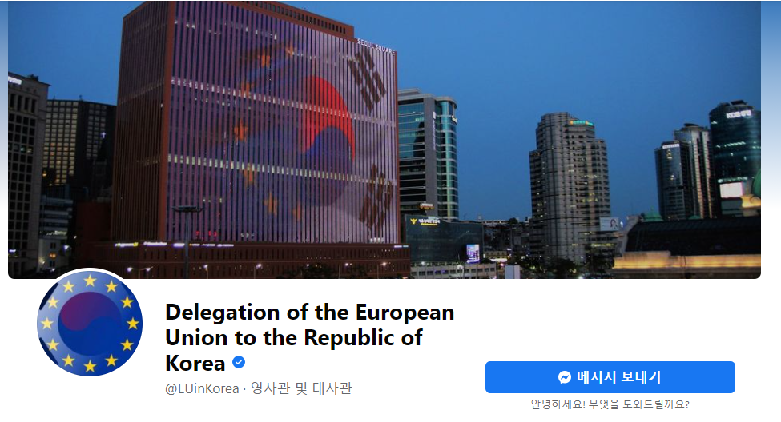
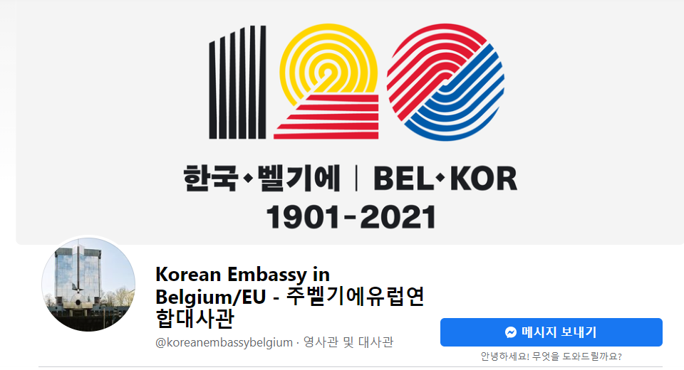
Monitored Social Media accounts in SK

Slide 5
2. Activeness of accounts (n=574)

Slide 9
Other hot issues in EUD account

Slide 10
Other hot issues in MFA account

Slide 11
3. Sources (n=574)

Slide 12
Sources of reposts
 | EUD |  | MFA
 | 2020 | 2021 | 2020 | 2021
1st | KEN-Korea EU CSO Network | KEN-Korea EU CSO Network | SK MFA | SK MFA
2nd | EEAS | EEAS | SK Cultural and Information Service | 2021 P4G Seoul Summit official page
3rd | European Commission | German Embassy in Seoul | SK Blue House | SK Emb. To BE/EU Official Page

Slide 13
4. Centrality of EU (n=574)

Slide 14
5. EUD’s Level of Focus (all posts)

Slide 15
Domesticity of MFA posts (all posts)

Slide 16
Domesticity of MFA’s EU posts

Slide 17
6. EU actions (Main/2nd focus)

Slide 18
Leading #hastag in EUD (Major/2nd)
 | 2020 | 2021
1st | #Covid19 | #EUinKorea
2nd | #EU | #ClimateAction
3rd | #EUinKorea | #EuropeDay

Slide 19
Intra-EU actions (Major/2nd)

Slide 20
Sub-frame of intra-EU actions (Main/2nd focus)
2020
 | EUD | MFA
Promoting our European Way of Life | Health Care | Health Care
An Economy that Works for People | - | State of Economy
A New Push for European Democracy | EU Values | Justice (Consumer Protection)
2021
 | EUD | MFA
Promoting our European Way of Life | - | Health Care
An Economy that Works for People | - | State of Economy

Slide 21
Extra-EU actions (Major/2nd)

Slide 22
Sub-frame of extra-EU actions (Main/2nd focus)
2020 & 2021
 | EUD | MFA
A stronger Europe in the world | CFSP
An Economy that Works for People | Economy | Economy/Trade
Promoting our European Way of Life | Health Care

Slide 23
7. Bilateral relation (Main/2nd focus)

Slide 24
Bilateral relation with South Korea (Main/2nd focus)
 |  | 2020 | 2021
EUD | 1st | EU ambassador’s TV interview | Europe Day Celebration
 | 2nd | Europe Day Celebration | EU-Korea bilateral diplomatic activities (EU Ambassador’s visit to Korean institutions)
 | 3rd | International Women’s Day Celebration | Bilateral Environmental Co-operation
MFA | 1st | Korean ambassador’s meeting with EU/Belgian officers | Korean ambassador’s meeting with EU/Belgian officers
MFA | 2nd | EU-Korea virtual summit on 30th June 2020 | EU-Korea MFA meetings (Ministerial level)
 | 3rd | EU-Korea Travel restrictions in COVID-19 context | EU-Korea Trade Statistics (EU Affairs)

Slide 25
8. Evaluation of EU (Major/2nd, n=157)

Slide 26
Evaluation of intra-EU actions
Response to Covid19
EU as a partner of Korea

Slide 27
Most popular posts of intra-EU story
 |  | Most liked | Most commented | Most shared
EUD | 2020 | EU MS Ambassadors in Korea deliver the message for COVID patients in Korea
MFA | 2020 | EU’s Current Trends
 | 2021 | EU’s Current Trends | - | -

Slide 28
Evaluation of extra-EU actions

Slide 29
Evaluation of extra-EU action (Main/2nd focus)
 |  | Leading +ve Story | Leading -ve Story
EUD | 2020 | EUD’s participation of South Korea’s ‘the Thanks to you Challenge’ | -
 | 2021 | Promoting EU Integration to External Viewers | -
MFA | 2020 | South Korea-EU Co-operation | South Korean government put Europe as a dangerous region of COVID-19
 |  |  | -
 | 2021 |  | Covid vaccine problems & economic downturn

Slide 30
Most popular posts of extra-EU story
 |  | Most liked | Most commented | Most shared
EUD | 2020 | EU Ambassador’s remarks on Europe Day in Korea
 | 2021 | Europe Day 2021 Celebration | EU Ambassador to Korea talks about the EU’s new policy strategy in the Indo-Pacific Region | Europe Day 2021 Celebration
MFA | 2020 | Press Conference after the EU-South Korea Leaders’ video call | EU South Korea Video Conference | Press Conference after the EU-South Korea Leaders’ video call
 | 2021 | Signing Ceremony of M.O.U for the further cultural cooperation between the Korean Embassy and BOZAR | Meeting with the President of the Chamber of Representatives of Belgium Ambassador YOON met with Madame Eliane Tillieux, President of the Chamber of Representatives of Belgium. | -

Slide 31
9. Self-image built by EUD (Main/2nd)
 | 2020 | 2021
1st | Partner of South Korea
2nd | Promoter of human rights | Green Europe
3rd | - | Promoter of equality

Slide 32
Expectation in EUD/MFA account (Main/2nd)

Slide 33
South Korea’s Expectation on EU
 | 2020 (3 expectation) | 2021 (2 expectations)
1st | Agreement partner in aviation safety management | Partner of Korea
2nd | A cooperation partner of Korea in green deal

Slide 34
Conclusions
COVID-19 shadow deteriorated in 2021.
EUD and MFA rarely covered the Brexit issues.
Other than these two issues, EUD (Gender Equality, Green Deal, Human Rights, North Korea and Indo-Pacific) and MFA (Data Protection, North Korea, Myanmar and Israel/Palestine) showed different interests regarding hot issues.
EUD and MFA are inclined to get the posts from their diplomatic headquarters (EUD—EEAS, MFA—SK Government).
In terms of Centrality, EUD has the highest percentage of major centrality, and MFA has the highest percentage of Nil centrality.

Slide 35
Conclusions (2)
EUD and MFA posts tended to have local focus (i.e. on Korea).
For the hashtag, EUD are most likely to have hashtags to promote EU Activities (2020: COVID-19 campaigns and support, 2021: Europe Day).
EUD and MFA rarely post negatively on EU.
There were no to low expectations towards EU.
The EU’s strongest self-image was a competent partner for South Korea.

