Slide 1
Developing a ‘Sense’ of Team Part 2: Applying Theory to Practice in High School Sport Teams
Lana McCarthy
&
Andy Martin

Slide 2
Overview
Team Culture & Leadership
Schein (2010) 3 level model
Applying Theory to Practice
Freyberg High School Football
Palmerston North Girls High School Netball

Slide 3
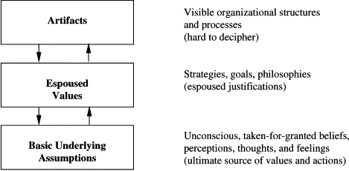
Team Culture & Leadership

Slide 4
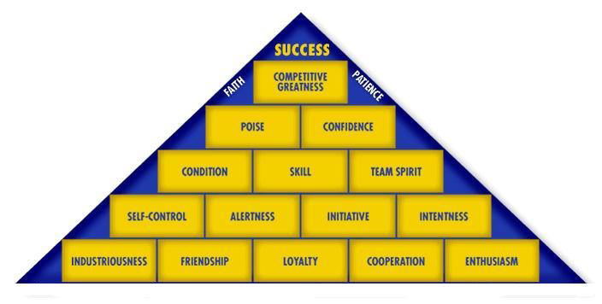
Regional: Freyberg High School 1st XI Girls Team Goals Values Team Top 8+ Make the Team look Good “We are Freyberg”

Slide 5
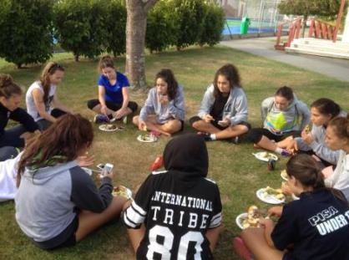
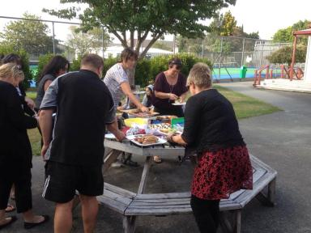
Regional: PNGHS – 1st team
Setting ‘great’ expectations
Player/parent BBQ

Slide 6
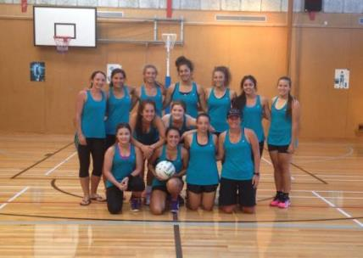
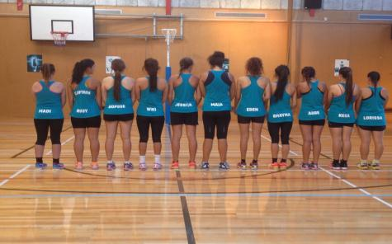
Developing rites, rituals & symbols
Naming of captain
Presentation of training singlets

Slide 7
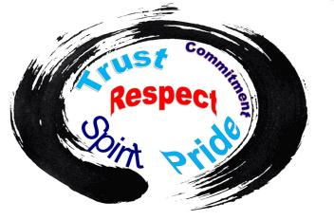
Developing values & leadership
Team values
private Facebook page
“Leadership” group
nominated by team members
‘buddy’ system

Slide 8
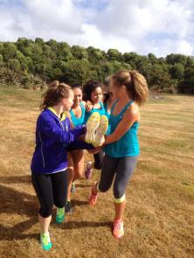
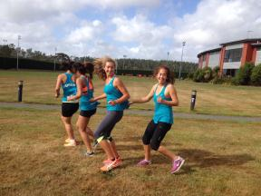
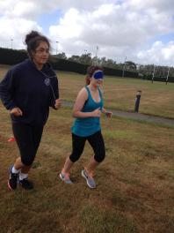
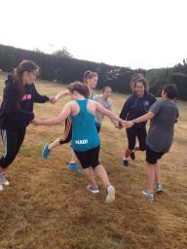
Team building
Regular team bonding sessions
- scheduled within season calendar
- team building session
- players socialise outside of netball
- Laser Tag & pizza

Slide 9
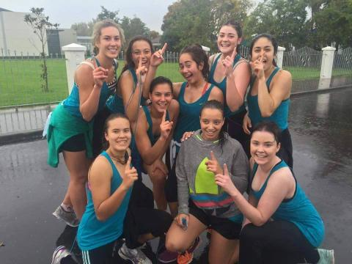
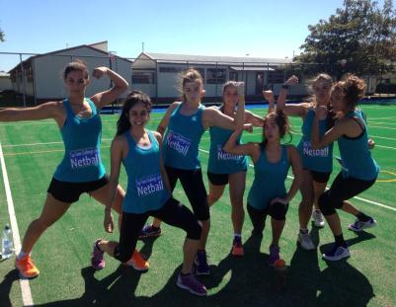
Evaluating the culture
Is it working?
Developed a sense of
pride

Slide 10
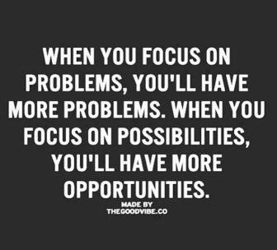
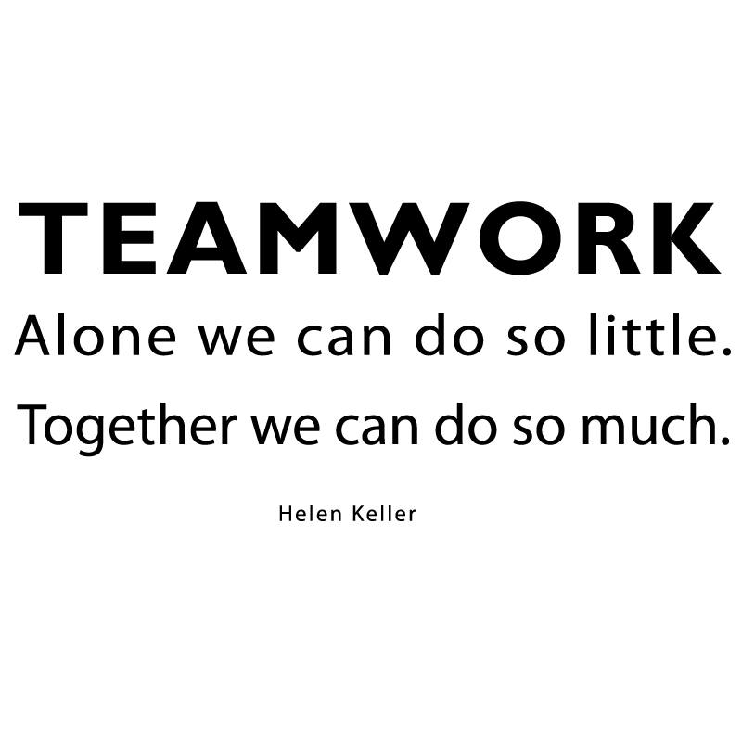
Collective leadership
Developed a sense of unity
“Don't forget, we are all in this together! #sisterhood #fam”

Slide 11
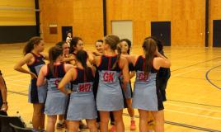
Developing a winning culture
Increase in success/winning
- Manawatu Premier One Grade, 6th place (4 wins in 2015 compared to zero wins in in 2014).
- Manawatu Open A Secondary School Grade, second place,

Slide 12
Conclusions
Leadership
Collective leadership in teams
Team culture
Application/adaptation of Schein’s theory to sport team culture
Artefacts (Rites, Rituals & Symbols)
Values
Core assumptions

Slide 13
References
Johnson, T., Martin, A. J., & Watson, G. (2014). Legends in black: New Zealand rugby greats on why we win. Auckland: Auckland. Penguin.
Johnson, T., Martin, A. J., & Palmer, F. R., Watson, G., & Ramsey, P. (2013). A core value of pride in winning: The All Blacks’ team culture and legacy. International Journal of Sport in Society, 4(1), 1-14.
Johnson, T., Martin, A. J., & Palmer, F. R., Watson, G., & Ramsey, P. (2013). Artefacts and the All Blacks: Rites & rituals, symbols & stories. Sporting Traditions Journal 30(1), 43-59.
Johnson, T., Martin, A. J., & Palmer, F. R., Watson, G., & Ramsey, P. (2012). Collective leadership: A case study of the All Blacks. Asia-Pacific Journal of Management and Business Application, 1(1), 53-67.

Slide 14
Developing a ‘Sense’ of Team Part 2: Applying Theory to Practice in High School Sport Teams
Lana McCarthy
&
Andy Martin

